Slide 1

[A] Group Presentation and Project:
US CRIMES FINAL PROJECT
Erica Hernandez, Thomas Fracassi, Maria Soto, Tai Harrell, & Joshua Alaniz

Slide 2
About The Database
Main Focus:
Hate crimes in the United States from the last few decades to today.
Relevant information readily available to all users to view and compare.
Data originated from Global Terrorism Database and Federal Bureau of Investigation

Slide 3
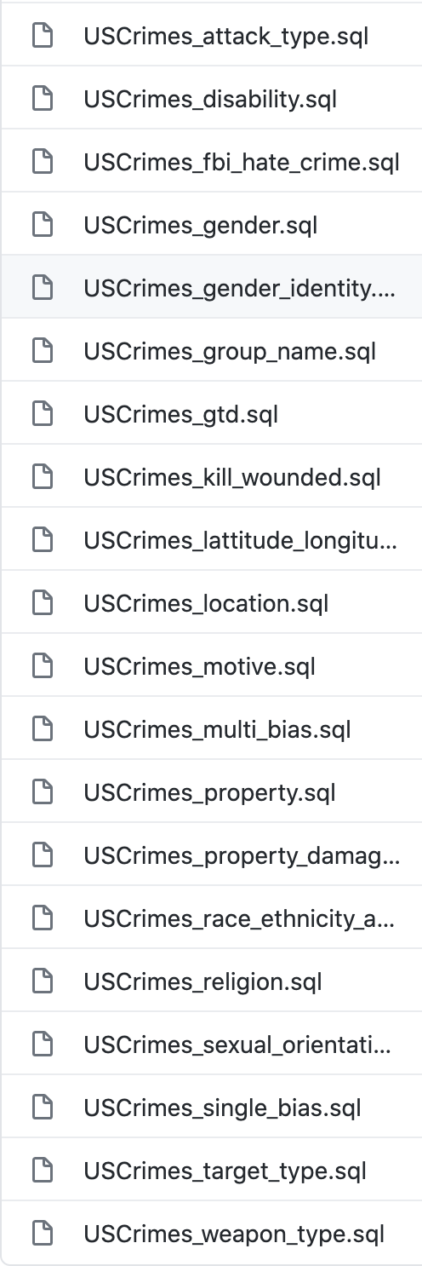
Database Design (Overview)

Slide 4
Low Impact Controls Implemented
US Crimes Database - Low Impact Controls Implemented
AC-2 - Account Management | CA-7 - Continuous Monitoring | PE-8 - Visitor Access Records
AC-7 - Unsuccessful logon attempts | CA-9 - Internal System Connections | PE-13 - Fire Protection
AC-8 - System Use Notification | CM-10 - Software Usage Restrictions | PS-3 - Personnel Screening
AC-14 - Permitted Actions without Identification or Authentication | CP-3 - Contingency Training | PS-4 - Personnel Termination
AC-17 - Remote Access | CP-9 - Information System Backup | PS-6 - Access Agreements
AT-4 - Security Training Records | IA-6 - Authenticator Feedback | RA-1 - Risk Assessment and Procedures
AU-8 - Time Stamps | IR-5 - Incident Monitoring | RA-2 - Security Categorization
CA-1 - Security Assessment and Authorization Policy & Procedures | IR-6 - Incident Reporting | RA-3 - Risk Assessment
CA-2 - Security Assessments | MA-1 - System Maintenance Policy and Procedures | RA-5 - Vulnerability Scanning
CA-3 - System Interconnecting | MP-2 - Media Access | SC-22 - Architecture And Provisioning For Name/ Address Resolution Service
CA-5 - Plan of Action and Milestones | MP-6 - Media Sanitation | SI-12 - Information Handling and Retention
CA-6 - Security Authorization | MP-7 - Media Use

Slide 5
Control (1/35): AC -2 Account Management
Identify roles and account types needed
Establishes conditions for information system (IS) accounts
Authorize privileges for each role
Implementation:
Database Administrator
Testing
Client
User

Slide 6
Control (2/35): AC-7 Unsuccessful Logon Attempts
Enforces a limit of consecutive invalid attempts
Auto lock account and delay next logon attempt
Implementation
Lock after five (5) consecutive attempts. Delay next logon attempt by 30 mins
*contact DBA for immediate release

Slide 7
Control (3/35): AC-17 Remote Access
Authorizes remote access to IS prior to allowing such connection
Establishes/documents restrictions, configurations/connection and implementation guidelines for remote access
Implementation:
Request for access must be authorized by DBA. User must use valid username and password to access database. Authorization must be recorded

Slide 8
Control (4/35): AU-8 Time Stamps
Use internal system clocks to generate timestamps for audit purposes
Timestamps GMT or UTC
Implementation:
Timestamps were added to each table using UTC - CST YYYY-MM-DD 00:00:00.000000.

Slide 9
Control (5/35): PS-6 Access Agreements
Develops, document, review and update access agreements for organization IS
Individuals accessing IS must sign agreement and re-sign when agreement is updated
Implementation:
Individuals requesting access to database must sign a User Policy Agreement (AUP)

Slide 10
Control (6/35): RA-5 Vulnerability Scanning
Scan vulnerabilities in the IS
Employ techniques that automate parts of the scanning process by using standards for test procedures, listing any platform used and their flaws, vulnerability impact, fixing a problem in accordance with assessment of risk and share info with team to avoid similar issues
Implementation:
Changed default MySQL port (3306), renamed MySQL username previously ‘root’, enforce unsuccessful logon attempts (see AC-7)

Slide 11
Control (7/35): PS-3 Personal Screening
Screen individuals prior to authorizing access to database and define rescreening process
Implementation:
User cannot access database until granted a username by DBA and has signed and AUP
User must have some familiarity using SQL

Slide 12
Control (8/35): PE-13 Fire Protection
Employ and maintain fire suppression and detection devices for the IS and that are supported by an independent energy source
Implementation:
Client is required to provide documentation with up to date maintenance information for sprinkler system, smoke detectors and fire extinguisher in facility

Slide 13
Control (9/35): CA-2 Security Assessment
Develop assessment plan for security controls, effectiveness of controls, environment, team, roles and responsibilities
Produce a security report documenting result of an assessment and making sure it gets to the right person
Implementation:
Client is required to coordinate with DBA and tester to assess security controls, provide plan, and follow plan and notify the team if any changes are made to the plan when necessary

Slide 14
Control (10/35): AC-8 - System Use Notification
Displays a Warning screen, prior to granting access to the system.
1.Users are accessing a U.S. Government information system
2.Information system usage may be monitored, recorded, and subject to audit
3.Unauthorized use of the system is prohibited and subject to criminal and civil penalties
4.Use of the system indicates consent to monitoring and recording
Retains the notification message or banner on the screen until users acknowledge the usage conditions and take explicit actions to log on to or further access the information system

Slide 15
Control (11/35):
AC-14 - Permitted Actions without Identification or Authentication
This control addresses instances where no identification and authentication is required.
It does not, however, require that such instances exist in a given information system.
In instances where identification and authentication is not required, the information system should ensure to:
1.identify/document specific user actions allowed on the system(s)
2.document the supporting rationale for not requiring identification and authentication, and
3.specify any conditions for bypassing identification and authentication in emergency situations.

Slide 16
Control (12/35): AT-4 – Security Training Records
Document and monitor individual information system security training activities
Tracking and reporting security training information:
1. Name of employee
2. Dates and timeframe of training
3. Topics or subject areas covered
4. Any training certifications or completion confirmation
Organization Supervisors are responsible for tracking status of all their reporting employees and to review their progress annually.

Slide 17
Control (13/35): CM-10 – Software Usage Restrictions
The organization:
a. Uses software and associated documentation in accordance with contract agreements and copyright laws;
b. Tracks the use of software and associated documentation; and
c. Controls and documents the use of peer-to-peer file sharing technology
Software license tracking will be accomplished with the use of simple spreadsheets, to record all pertinent software and licensing information.

Slide 18
Control (14/35): CP-3 – Contingency Training
The organization provides contingency training to information system employees consistent with assigned roles and responsibilities:
a. Within the organization-defined time period of assuming a contingency role or responsibility;
b. When required by information system changes; and
c. With the organization-defined frequency thereafter
Organization Supervisors are responsible for tracking status of all their reporting employees and to review their progress annually.

Slide 19
Control (15/35): IA-6 Authenticator Feedback
The information system obscures feedback to protect the information from possible exploitation/use by unauthorized individuals.
The feedback from information systems does not provide information that would allow unauthorized individuals to compromise authentication mechanisms.
For example:
a.Larger monitors which may allow others to see private information
b.Hiding a password on login by displaying asterisks
c.Or a standard user trying to execute a command without proper permission

Slide 20
Control (16/35):
MA-1 – System Maintenance Policy and Procedures
The organization:
Implemented in the MA-1_PolicyAndProcedure document.
a. Develops, documents, and disseminates to organization-defined personnel or roles:
1. A system maintenance policy and
2. Procedures to facilitate the implementation of the system maintenance policy and
b. Reviews and updates the current:
1. System maintenance policy according to organization-defined frequency; and
2. System maintenance procedures according to organization-defined frequency.
Implemented by the MA-1_PolicyAndProcedure document.

Slide 21
Control (17/35): PE-8 – Visitor Access Records
The organization utilizes an electronic card reader entry/exit system to log entrance/exit
Any visitor without an electronic card must enter and check-in at the front desk
The desk attendant will contact the escort (person visitor) came to see
The escort accompanies the visitor for the duration of their visit
At the end of the visit, the escort and visitor return to main desk to check out and leave
The organization employs automated mechanisms to facilitate the maintenance and review of visitor access records.

Slide 22
Control (18/35): RA-1 Risk Assessment Policy and Procedures
Policy that addresses the implementation of the current risk assessment policy and the steps done to maintain it (procedures). This policy addresses: purpose, scope, roles, responsibility, management commitment, coordination among entities.
Regular reviews of current risk assessment policies and procedures.
Solution: Implementation of the Risk Assessment Policy and Procedures

Slide 23
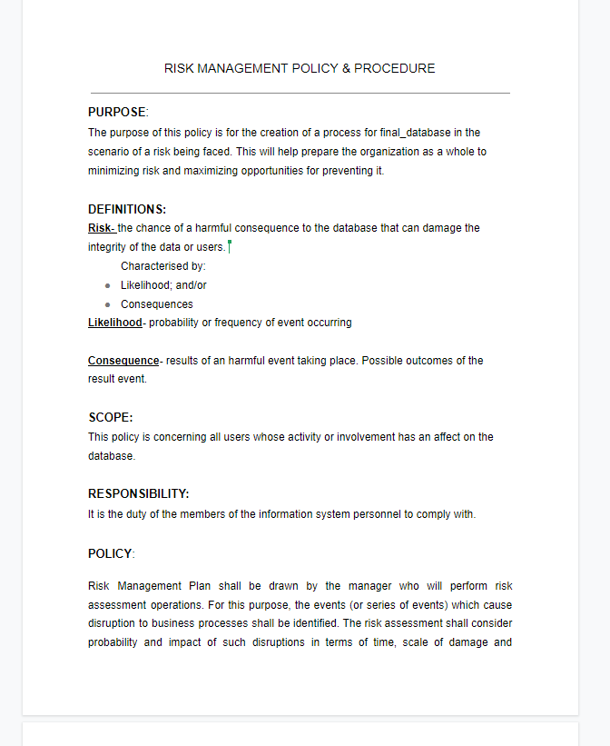
Control (18/35): RA-1 Risk Assessment Policy and Procedures

Slide 24
Control (19/35): RA-2 Security Categorization
Information and information Systems are in compliance with local and federal laws.
Proper documentation of security categories.
Assurance that the database administrator has approved of all security categories defined.
Solution: Implementation of Security Categorization document

Slide 25
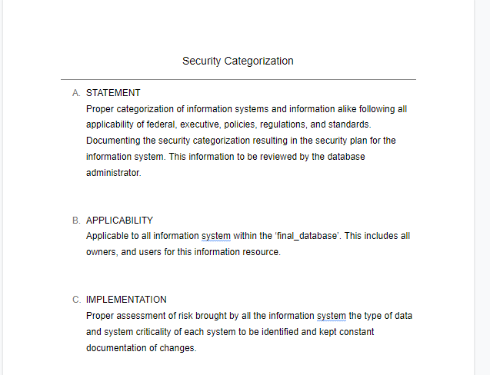
Control (19/35): RA-2 Security Categorization

Slide 26
Control (20/35): RA-3 Risk Assessment
Going through a risk assessment for identifying the chance of harm occurring from external or internal entities
Documentation of risk assessment results
Review results
Communicate results to related parties
Revisiting risk assessment and making changes as needed that may impact the integrity of the system.
Solution: Implementation of the Risk Assessment Overview Spreadsheet

Slide 27
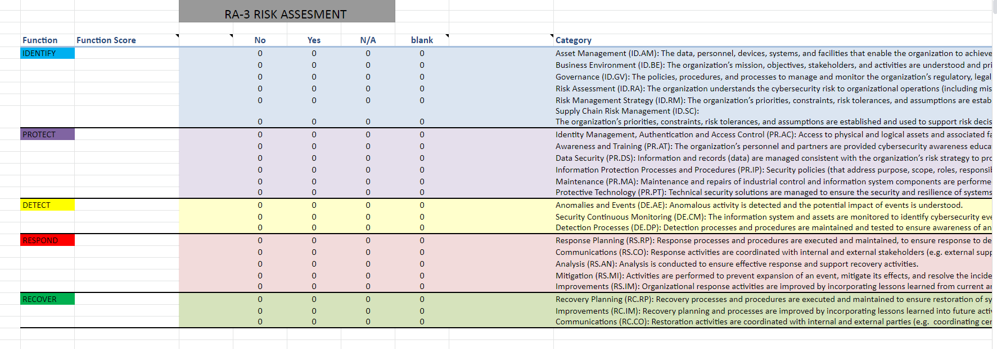
Control (20/35): RA-3 Risk Assessment

Slide 28
Control (21/35): CA-1 Security Assessment and Authorization Policy and Procedures
Creation of policy containing security assessment, scope, purpose and employee interaction with the information system
Development of procedures and protocols to follow in events
Constant review and update of this policy
Solution: Implementation of the Security Assessment and Authorization Policy, under section Policy

Slide 29
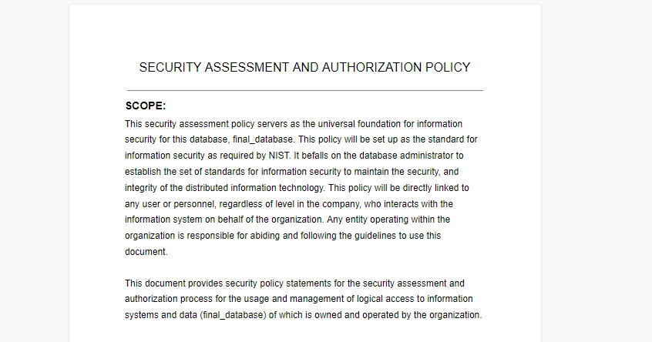
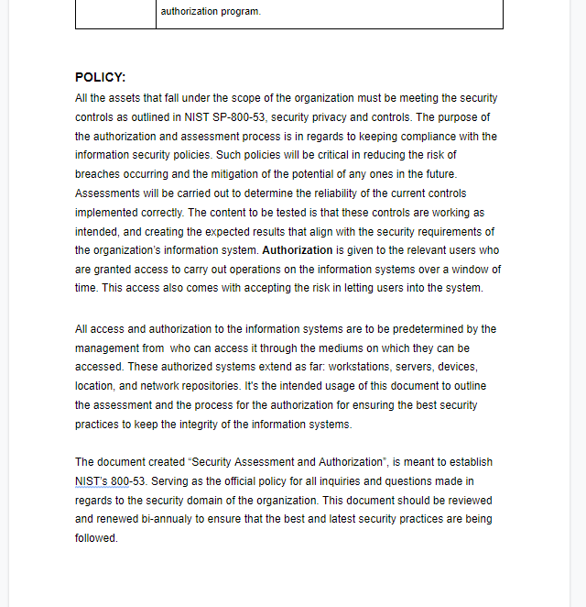
Control (21/35): CA-1 Security Assessment and Authorization Policy and Procedures

Slide 30
Control (22/35): CA-3 System Interconnections
Verification of connections from the information technology systems to other information technology systems.
Documentation to keep track of each outbound connection made and accepted
Normal review of security requirements
Solution: Implementation of the Security Assessment and Authorization Policy, under section System Interconnections Security

Slide 31
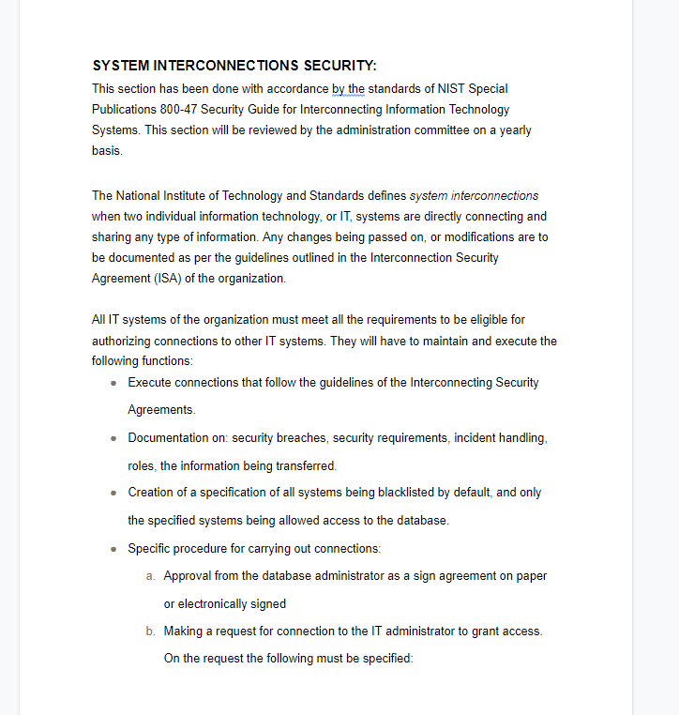
Control (22/35): CA-3 System Interconnections

Slide 32
Control (23/35): CA-6 Security Authorization
Assignment of an administrator level for authorization of the database
Confidence in administrator authorizing all operations on the information system
Normal updates on security authorization.
Solution: Implementation of the Security Assessment and Authorization Policy, under section Security Authorization

Slide 33
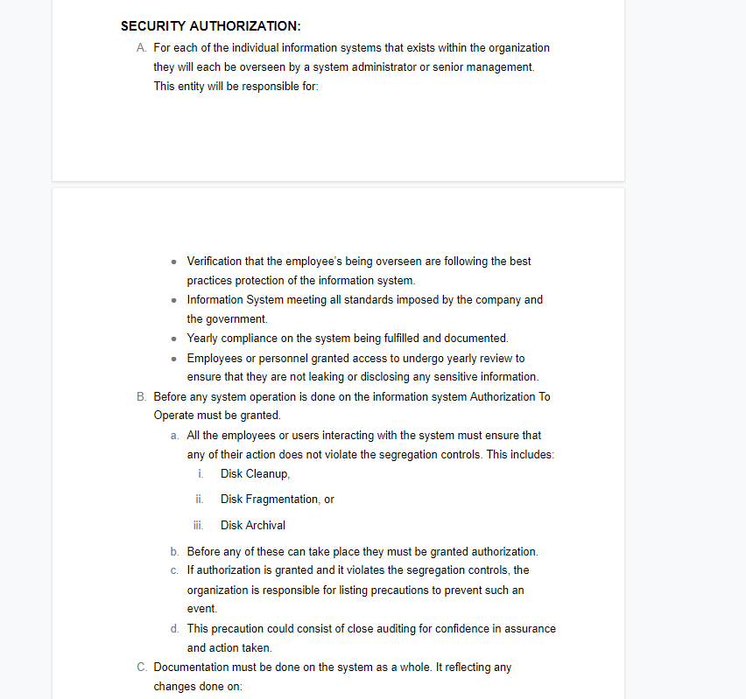
Control (23/35): CA-6 Security Authorization

Slide 34
Control (24/35): CA-7 Continuous Monitoring
Creation of metrics to be monitored
Creation of assessments to be monitored and supervised
Security control assessments
Analysis from security assessments and monitoring
Plan of action for responding to analysis
Reporting of security status organization
Solution: Implementation of the Security Assessment and Authorization Policy, under section Continuous Monitoring

Slide 35
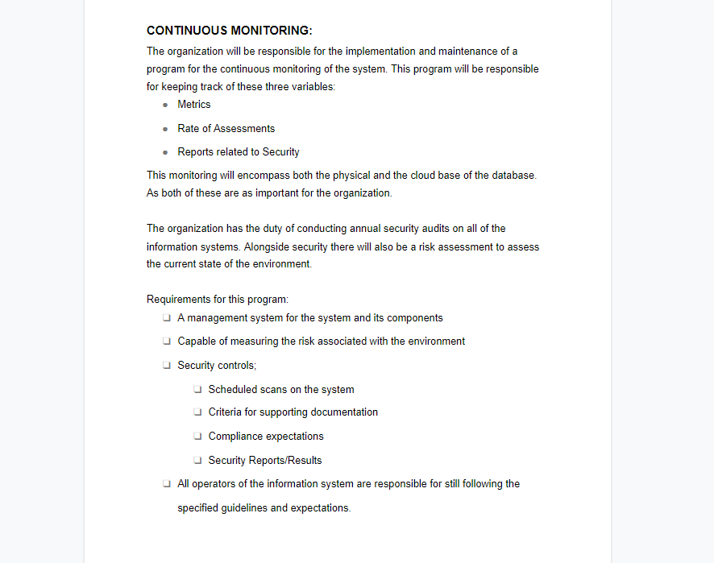
Control (24/35): CA-7 Continuous Monitoring

Slide 36
Control (25/35): CA-9 Internal System Connections
Authorization of connections within the information system to information systems
Documentation of all internal systems
Solution: Implementation of the Security Assessment and Authorization Policy, under section Internal System Connections

Slide 37
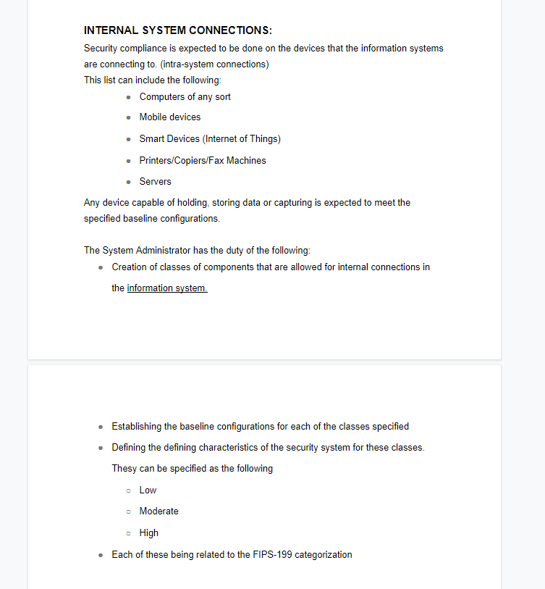
Control (25/35): CA-9 Internal System Connections

Slide 38
Control (26/35): PS-4 Personnel Termination
Disabling user access to the system
Terminate user’s credentials
Having user go through exit interview
Retrieving all property owned by the information system
Transfer terminated user’s privileges to other user still operating with the organization
Notification to system administrator and other users of termination
Solution: Application of the Personnel Termination Policy

Slide 39
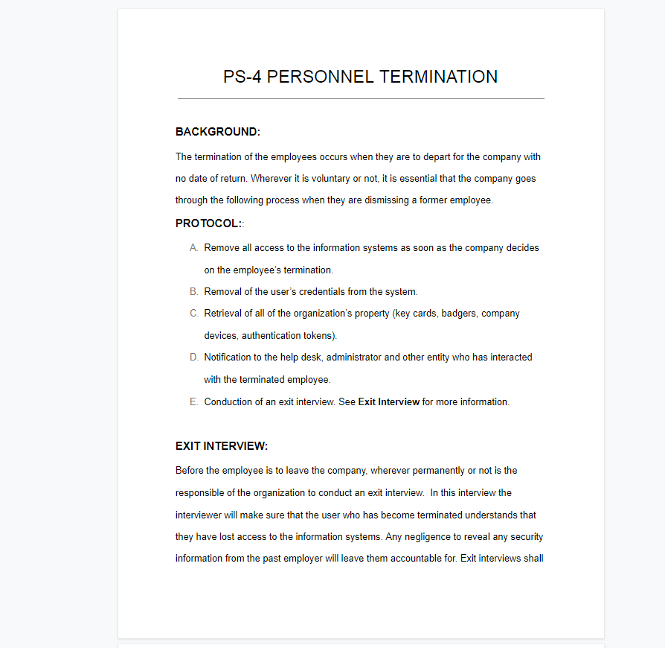
Control (26/35): PS-4 Personnel Termination

Slide 40
Control (27/35): MP-2 MEDIA ACCESS
The Organization restricts access to organization-defined types of digital media and/ or non-digital media.
Implementation: Only authorized personnel will have access to the media that contains the database

Slide 41
Control (28/35): CA-5 PLAN OF ACTION AND MILESTONES
Develops a plan of action and milestones for the information system to document the organization's planned remedial actions to correct weaknesses or deficiencies noted during the assessment of the security controls and to reduce or eliminate known vulnerabilities in the system
Implementation: Keeping documentation of the strengths and weaknesses of our system and implementing changes accordingly

Slide 42
Control (29/35):CP-9 INFORMATION SYSTEM BACKUP
Conducts backups of user-level information contained in the information system [Assignment: organization-defined frequency consistent with recovery time and recovery point objectives];
Conducts backups of system-level information contained in the information system [Assignment: organization-defined frequency consistent with recovery time and recovery point objectives];
Implementation: Back up our system so it is disaster proof

Slide 43
Control (30/35): IR-5 INCIDENT MONITORING
Track and document information system security incidents.
Implementation: Keeping records of any security issues for our system

Slide 44
Control (31/35): IR-6 INCIDENT REPORTING
a. Requires personnel to report suspected security incidents.
b. Reports security incident information
Implementation: Any and all security incidents in the system will be reported by all personnel.

Slide 45
Control (32/35): MP-7 MEDIA USE
Restricts/prohibits the use of defined types of information system media on organization defined information systems or system components.
Implementation: Specific media is not to transfer data with the information system. .

Slide 46
Control (33/35): MP-6 MEDIA SANITATION
Sanitizes organization defined information system media prior to the disposal, release out of the organization's control, or release reuse by using organization-defined sanitation techniques and procedures with the applicable federal and organizational standards and policies.
Brings sanitation mechanisms with the strength and integrity commensurate with the security category or classification of the information.
Implementation: All media that is shared must be first sanitized to prevent the disclosure of information

Slide 47
Control (34/35): SI-12 INFORMATION HANDLING AND RETENTION
Handle and retain information in the information system and information output from the system with applicable federal laws, Executive Orders, directives, policies, regulations, standards, and operational requirements.
Implementation: All information held is retained according to federal laws.

Slide 48
Control (35/35): SC-22 ARCHITECTURE AND PROVIDING FOR NAME/ADDRESS SOLUTION
The Information systems that provide name/address resolution service for an organization are fault tolerant and they implement external and internal separation.
Implementation: Creating a primary and secondary server to make the system fault proof

Slide 49
Github Repository
Group Presentation and Project Github Link: https://github.com/msoto6/ITMD__321_Final_Project

